Slide 1

Embed
Property data platform
Geoffrey.stevens@est.org.uk
Nick.Lomax@est.org.uk

Slide 2
What is EMBED?
A database…
Scalable, real time processing of vast amounts of data to provide useful information to consumers and valuable insight to industry
Non-proprietary – accepts data from any web enabled device
  Smart meters, smart controls, appliances, weather sensors
Standardised protocols to allow other applications to use embed
Provides services including analysis, visualisation and storage Smart data, building design, performance, and occupant data to provide valuable insight
Notes:
EMBED provides - scalable, cloud based, big data storage and analysis
EMBED can Accept data from any source:
Smart meters
Any home energy monitoring solution (Nest, Loop, Owl, etc)
Other sensors such as temperature, CO2, humidity, weather data
Smart appliance data
Offline research project data

Slide 3
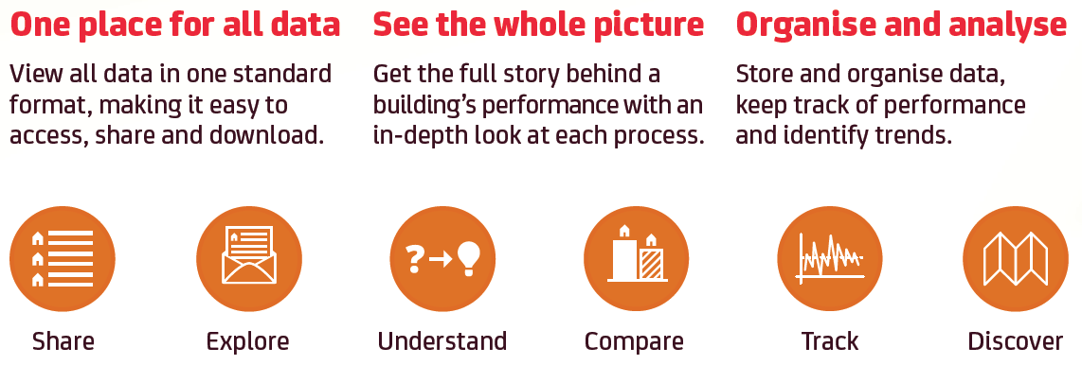
Embed
  getembed.com
Notes:
Provides a central web repository to storing and share information generated by programmes investigating ways of improving the energy efficiency of buildings
Secure web based access
Stores contextual data about buildings and measurement data from meters or sensors, such as temperature and humidity
Quickly visualise data
Search the database of properties to understand and compare performance

Slide 4
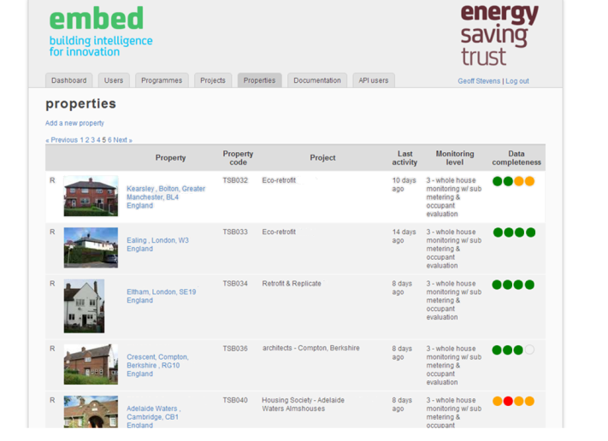
Data and insight
Bringing monitoring projects together
Multiple large scale programmes already in EMBED
Can add context to smaller scale monitoring projects

Slide 5
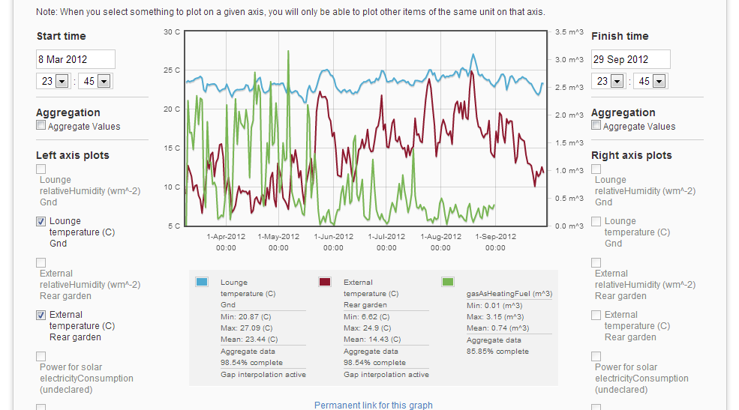
Interactive graphing of monitoring data
Multiple large scale programmes
Add context to smaller scale monitoring projects
Notes:
Shows 6 months worth of internal temp external temp and gas use
Also shows min, mean, max, cumulative totals - fast access to analytics
This graph shows that the householder likes it hot! Avg internal temp of 23. you can see gas use increasing in winter then reducing towards summer as external temp goes down
You can permalink to any graphs to give anyone access to a graph you have made or so you can return to it at a later date.

